Slide 1



File
Edit
Format
View
Bootcamp: Quantum Computing
COF Alumni USB
B
I
U
Quantum Machine Learning Project
Alan Vásquez, Ángel Álvarez, Gaby Linares, Jaisar Cammarata, Luis Viloria, Milagro Rojas
Tutor:
April, 2022
Alberto Maldonado Romo

Slide 2
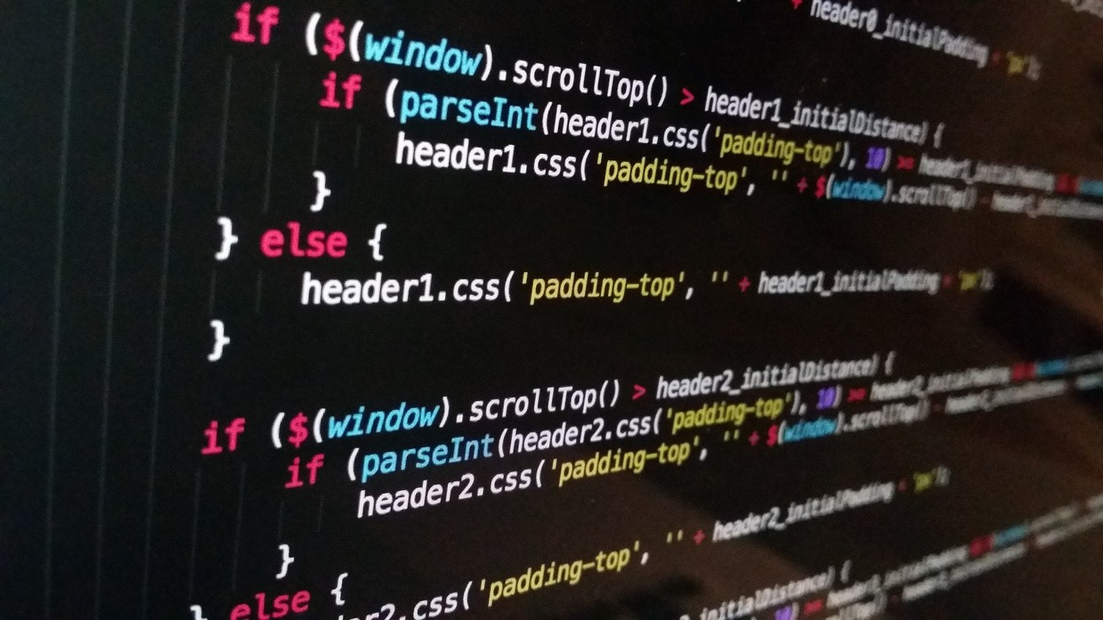
Bootcamp: Quantum Computing
Page 1
Introduction
What is machine learning?
Machine learning, ML, is considered as an emerging discipline.
ML is a field of artificial intelligence that searches patterns in a data set in an empirical way and creates prediction models by applying statistical methods.
Classification:
Supervised learning Unsupervised learning Reinforcement learning

Slide 3
Bootcamp: Quantum Computing
Page 2
Introduction
 | Supervised learning, the algorithms use “labeled” data as input, to find a function that assigns an output label. Is common to use it in classification and regression problems.
Supervised, unsupervised and reinforcement learning
 | Unsupervised learning there is no "tagged" data, only the input data is available, without knowing the corresponding output data. Is often used in clustering and correlation problems.
 | Reinforcement learning is based on trial and error.The algorithm learns by observing the world around it.

Slide 4
Bootcamp: Quantum Computing
Page 3
Introduction
Supervised learning
Decision trees.
Naïve Bayes classification. Least squares regression.
Logistic regression.
Support Vector Machines (SVMs). “Ensemble” methods (Sets of classifiers).
Machine learning algorithms
Unsupervised learning
Clustering algorithms. Decomposition into singular values.
Principal Component Analysis (Independent Component Analysis)

Slide 5
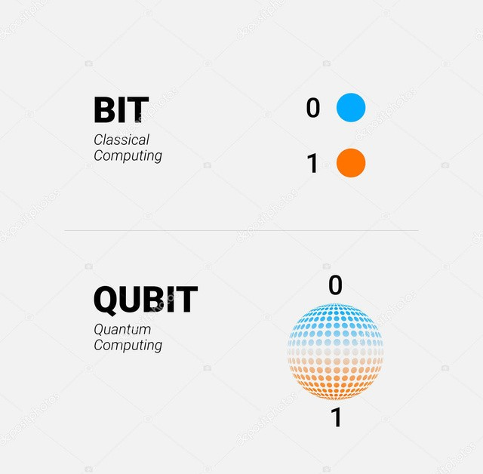


Bootcamp: Quantum Computing
Page 4
Introduction
What is a qubit?
A qubit is the smallest unit of quantum information consisting of a two-level quantum system defined as the states |0⟩ and |1⟩.
When measuring a qubit, it will collapse into one of two possible states and display a single result: the |0⟩ state or the |1⟩ state.

Slide 6
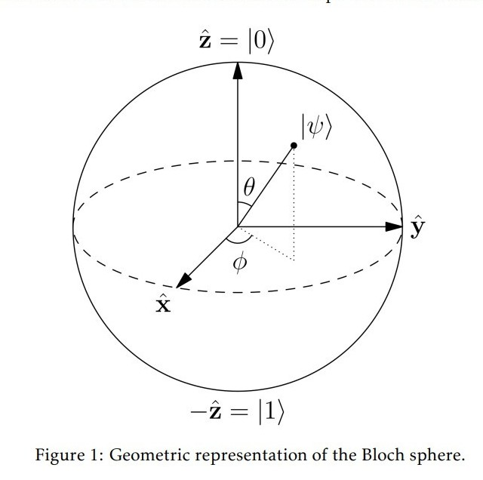
Bootcamp: Quantum Computing
Page 5
Introduction
Quantum gates and quantum circuits
A qubit can be
represented in a Bloch gates are
sphere. operations rotations
logical associated with possible
Quantum
about a certain axis
this
of the bloch
Bloch. The rotations over
sphere are known as quantum gates.
The combination of them in a set of qubits is known as a quantum circuit

Slide 7
Page 6
Motivation
Bootcamp: Quantum Computing
Goals
Choose the better way to encode classical data in
Why use quantum machine learning?
terms of qubits and a variational circuit proposed by
the Qiskit framework that achieves a binary classification.
Demonstrate the knowledge to define our own variational circuit and identify the number of layers to perform against the 100% accuracy metric.

Slide 8
Bootcamp: Quantum Computing
Page 7
Methods
The classification recreates the classification with a variational circuit in which classical value is passed to be interpreted by a quantum computer.
Data sample
A training data set and a test data set were worked on each of them having 4 features and 1 label.

Slide 9

Bootcamp: Quantum Computing
Page 8
Methods
 | Qiskit is a software development kit to work with quantum computers. Is based primarily on Python and provides tools for creating and manipulating quantum programs and running them on quantum device prototypes in IBM Quantum Experience or in simulators on a local computer. The packages qiskit, qiskit-utils, qiskit- aqua were used. Additionally, we worked with the Matplotlib, Pandas and Numpy libraries.
Qiskit

Slide 10
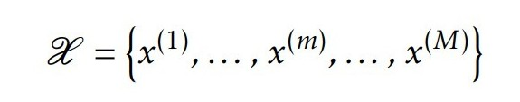
Bootcamp: Quantum Computing
Page 9
Methods
Encoding data methods
How to represent and efficiently input the data into a quantum system, so that it can be processed by a quantum machine learning algorithm?
We have a data set X , consisting of M samples each of them having N entries or features
Where each of the elements x^(m) is an N dimensional vector and m = 1,...,M
Which embedding technique can we use to represent X into a quantum system?
Basis encoding. Amplitude encoding. Angle encoding.
Arbitrary encoding.

Slide 11
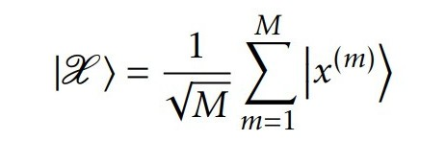
Bootcamp: Quantum Computing
Page 10
Methods
Basis encoding
Basis encoding associates a classical N-bit string with a computational basis state of an N-qubit system.
For a N-bit string, the corresponding N-qubit state is
x^(m) = | |b1b2 ...bN | ⟩ with | bn | ∈ {0, | 1} | for | n | = | 1, | 2, | ...,N | and
m = 1, | 2, ...,M.

Slide 12
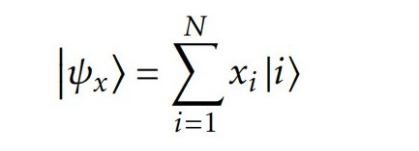
Bootcamp: Quantum Computing
Page 11
Methods
Amplitude encoding
Amplitude encoding encodes represents a normalized
data into the amplitudes of a quantum classical N-dimensional
state. It as the
datapoint, x,
amplitudes of a n-qubit quantum state, |ψx⟩ :
where n=2N; xi is the ith element of x and |i⟩ is the i th computational quantum state

Slide 13
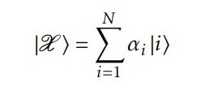
Bootcamp: Quantum Computing
Page 12
Methods
Amplitude encoding
We concatenate all M N-dimensional datapoints into one amplitude vector, of length N × M:
Where ANorm is a normalization constant, such that |α| 2 = 1. The data set X
can now be represented in the computational basis as:

Slide 14
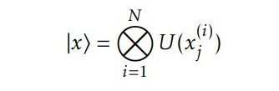
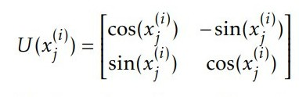
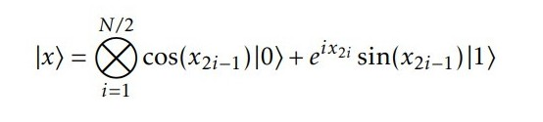
Bootcamp: Quantum Computing
Page 13
Methods
Angle encoding
Angle encoding encodes N features into the rotation angles of n qubits, where
N ≤ n:
where:
Dense angle encoding is a slight generalization of angle encoding, encodes two features per qubit using the relative phase, where the
x = (x1, ..., xN ) datapoint can be encoded as:
that

Slide 15
Bootcamp: Quantum Computing
Page 14
Method
Variational algorithms
 | Variational algorithms use a parameterized quantum circuit, U (θ), to prepare the state |ψ(θ)⟩ = U (θ) |0⟩, and measure the expectation value using a quantum computer. We define a cost function C(θ), which determines how good θ is for the problem we are trying to solve. We then use a classical computer to calculate the cost function and provide updated circuit parameters using an optimization algorithm. The goal of the algorithm is to find the circuit parameters θ for the parameterized quantum circuit U (θ) that minimizes the cost function C(θ).

Slide 16
Bootcamp: Quantum Computing
Page 15
Method
Variational algorithms

Slide 17
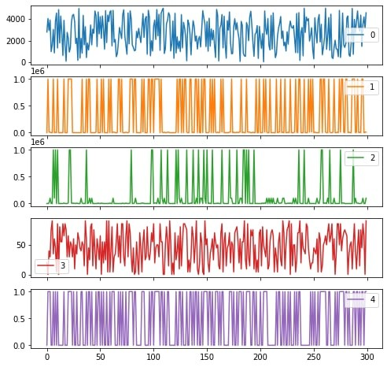
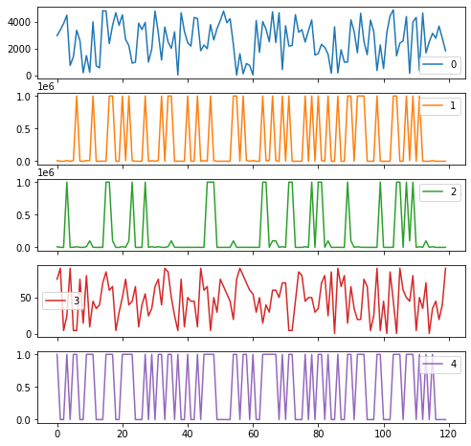
Bootcamp: Quantum Computing
Page 16
Results
Determining the class
Train first look data set:
Test first look data set:

Slide 18
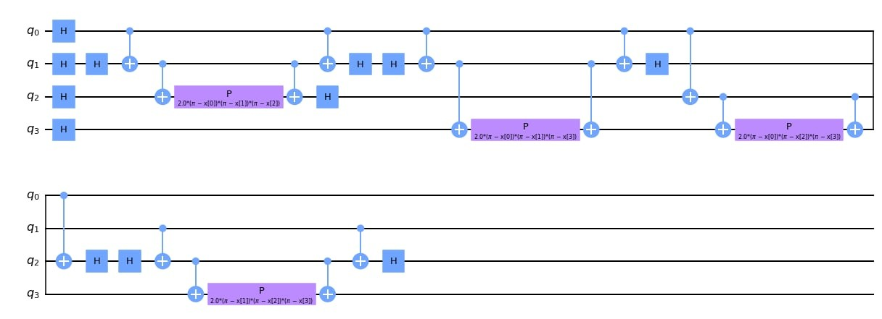
Bootcamp: Quantum Computing
Page 17
Results
Determining the class
Pauli feature map:

Slide 19
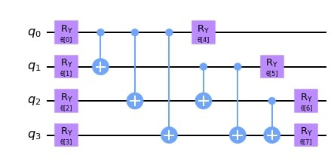
Bootcamp: Quantum Computing
Page 18
Results
Determining the class
Two Local circuit:

Slide 20
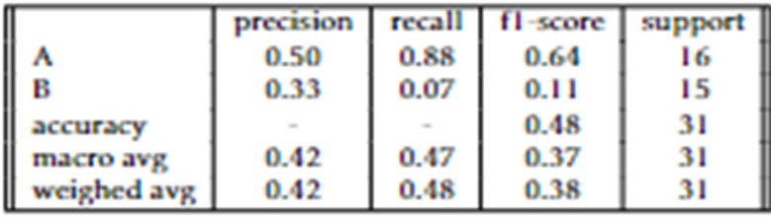
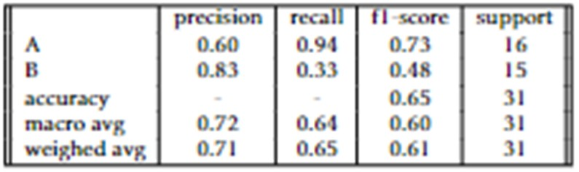
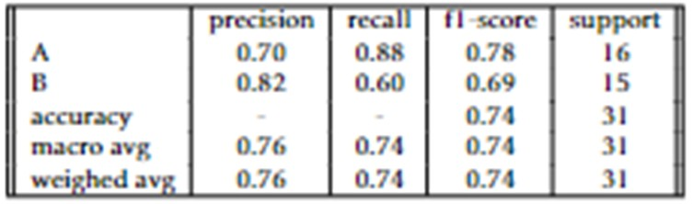
Bootcamp: Quantum Computing
Page 19
Results
Testing our algorithm
Pauli feature map (PFM) using VART TowLocal:
Confusion matrix for PFM (1) and VAR TwoLocal(3)
Confusion matrix for PFM (2) and VAR TwoLocal(1)
Confusion matrix for PFM (2) and VAR TwoLocal(2)

Slide 21
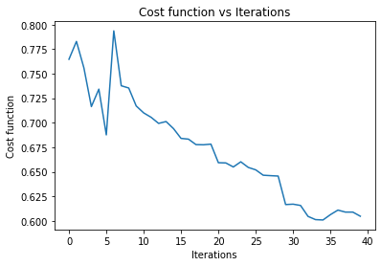
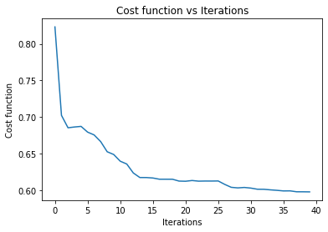
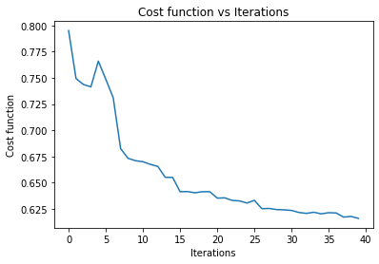
Bootcamp: Quantum Computing
Page 20
Results
Testing our algorithm
Pauli feature map (PFM) using VART TowLocal:

Slide 22
Bootcamp: Quantum Computing
Page 21
Conclusions
Conclusions
 | According to the data in the tables, the best parameters for the Pauli feature map and the VAR TwoLocal are the 2 repetitions for each one. The criteria to establish an optimal performance is the maximization of precision. In the previous tables, it can be seen that the precision of the last table is the highest. Visually, we can observe how is the path that took the cost function with respect to the iterations. As an extra task, it could extand this work by demonstrating with respect to a classical equivalence using neural networks to identify with the ROC curve which is the best and identify the limitations of quantum machine learning using a real quantum computer with a maximum of 5 qubits.

Slide 23
Bootcamp: Quantum Computing
File
Edit
Format
View
Thank You For Listening! :)
Do | you | have | any | questions | for | me?

